Slide 1

WAY TO ENTERPRISE
Advanced Java
VTI ACADEMY
Author: duy.nguyenngoc1@vti.com.vn
March 2020

Slide 2
Agenda
Top-down Coding & Bottom-up Coding
SOLID principles
IoC & DI
Spring core
Spring introduction
Cross Origin
Assignments
Copyright © VTI Academy All Rights Reserved

Slide 3
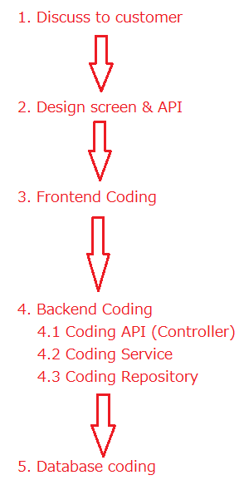
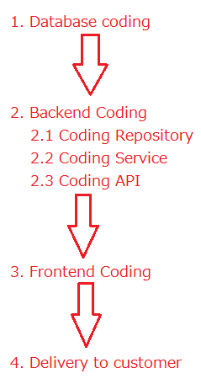
Top-down Coding & Bottom-up Coding
Bottom-up coding
Top-down coding

Slide 4
Top-down Coding & Bottom-up Coding
Bottom-up Coding
Easy to miss customer requirement
Familiar to student
Top-down Coding (recommended)
Focus to customer requirement
Familiar to employee

Slide 5
SOLID Principles
SOLID makes the code easier to refactor and maintain, but takes longer to write
Principles
1. Single responsibility
2. Open/closed
3. Liskov substitution
4. Interface segregation
5. Dependency inversion

Slide 6
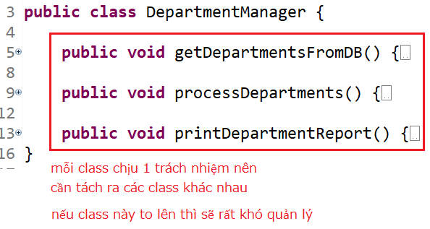
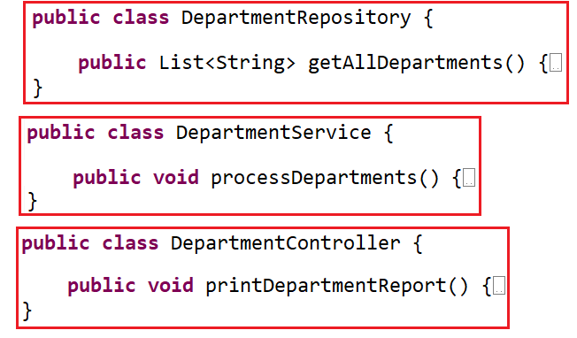
SOLID Principles
1. Single responsibility
A class should only hold 1 responsibility ➔ Classes can only be modified for only a reason

Slide 7
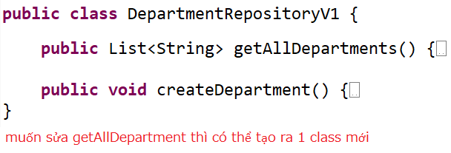
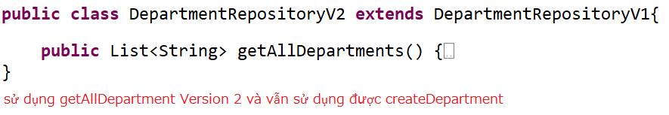
SOLID Principles
2. Open/closed
It is possible to extend a class freely, but not modify it within that class
When you want to add functionality to the project, you should write a new class that is an extension of the old class (extend or has-a)

Slide 8
SOLID Principles
3. Liskov substitution
In a program, objects of SubClass can replace SuperClass without changing the correctness of the program
4. Interface segregation
Divide the large interface into many small interfaces with specific purposes

Slide 9

SOLID Principles
5. Dependency inversion
High-level modules should not depend on low-level modules (has-a relationship)
➔ Both should depend on abstraction/interface
Interface (abstraction) should not depend on details, but the opposite.
Classes communicate with each other through interfaces, not through implementations.

Slide 10
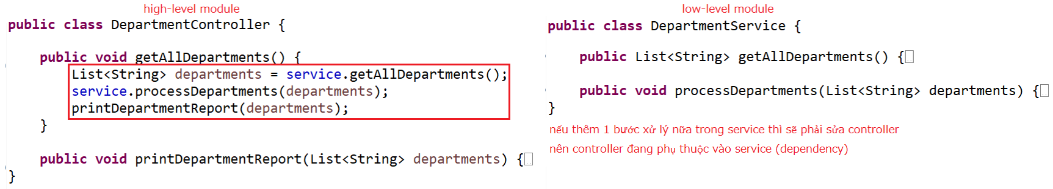
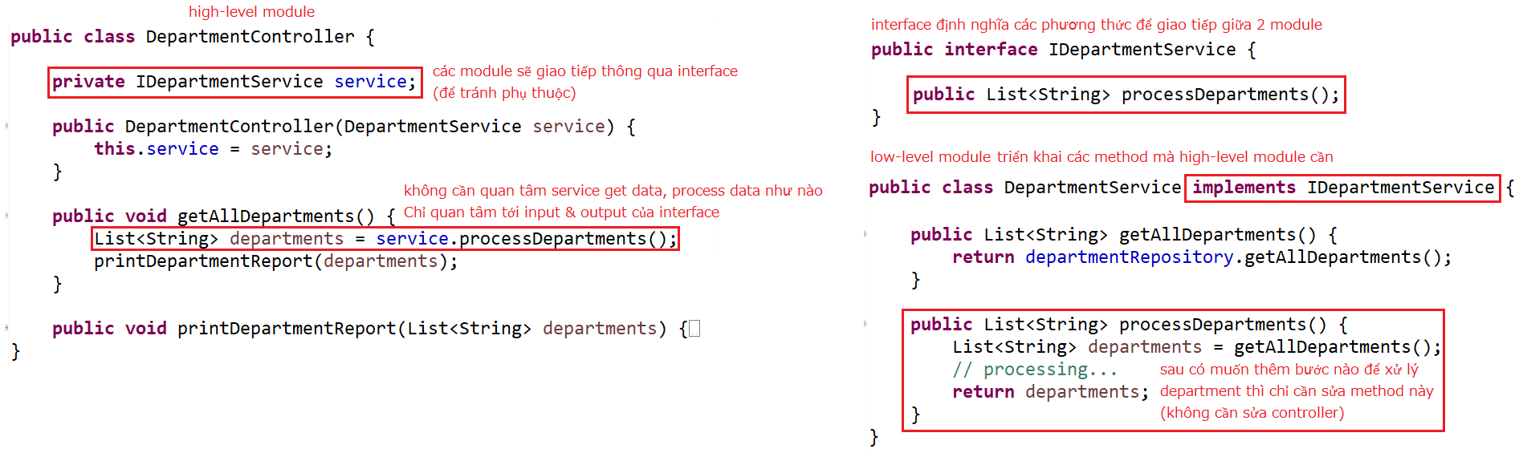
SOLID Principles
Dependency

Slide 11
Testing System Assignments
Self-practice

Slide 12
Inversion of Control
Is a design pattern created to make the code compliant with Dependency Inversion
Provides a simple mechanism to manage dependencies, object initialization
2 ways
Dependency Injection
Dependency Lookup (self-study)

Slide 13
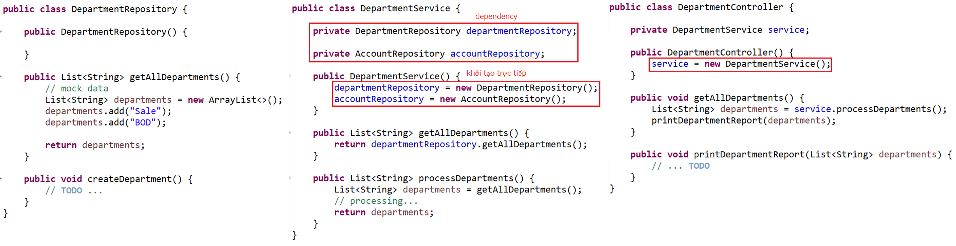
Dependency Injection
Problem

Slide 14
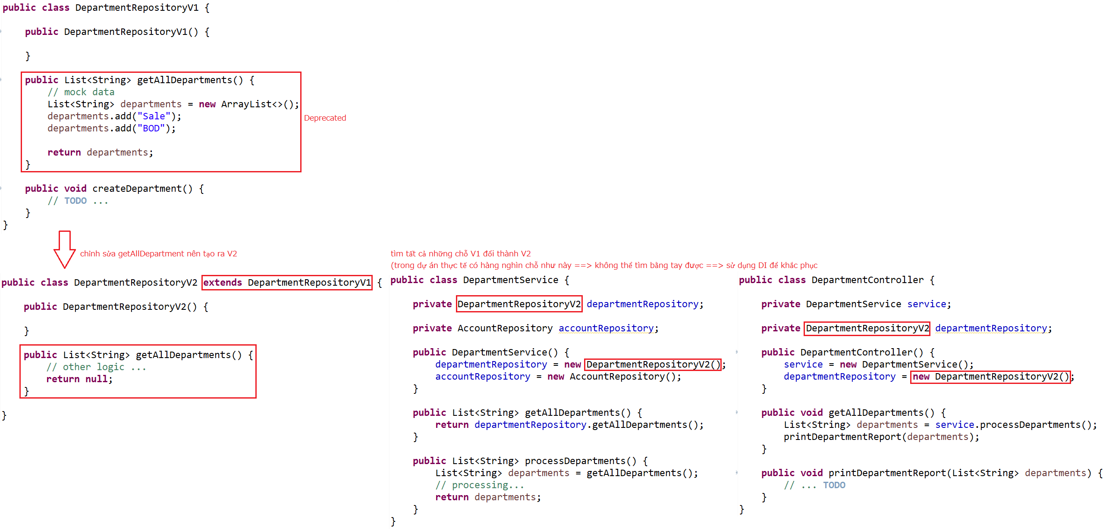
Dependency Injection
When you change the code in the low-level module, you will have to change it on the high-level module too

Slide 15
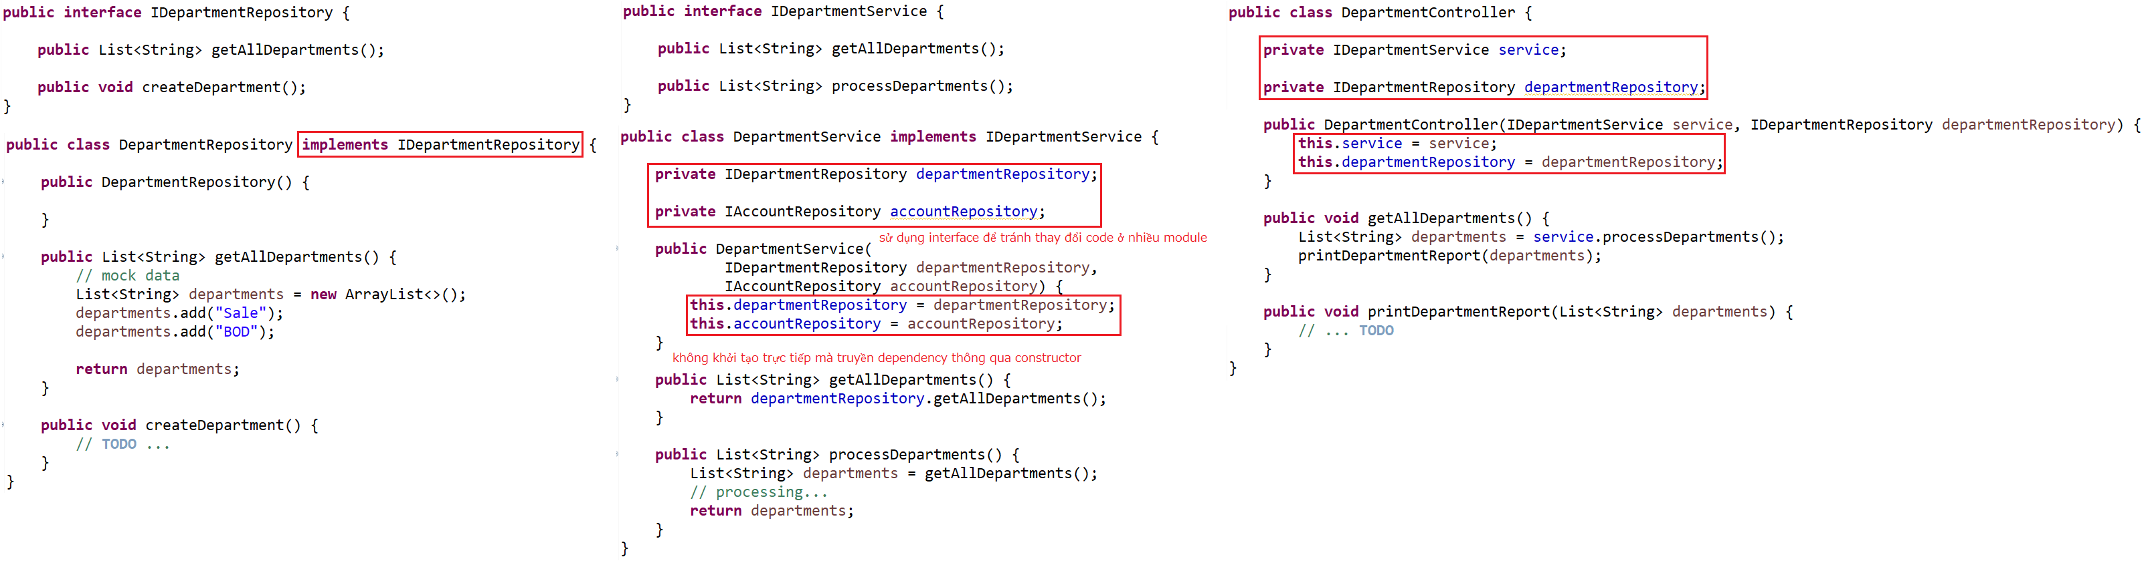
Dependency Injection
Using DI
Setup Component

Slide 16
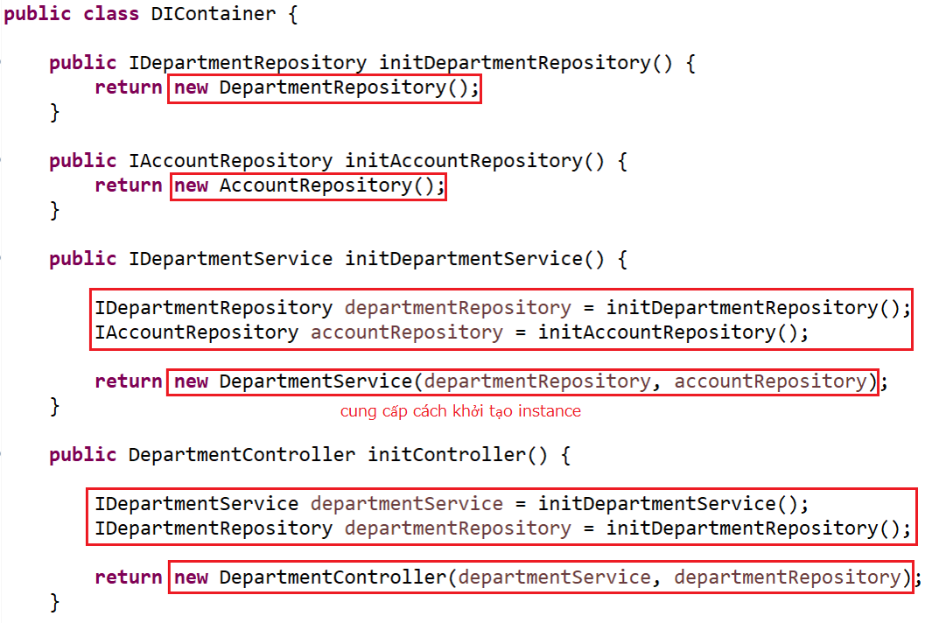
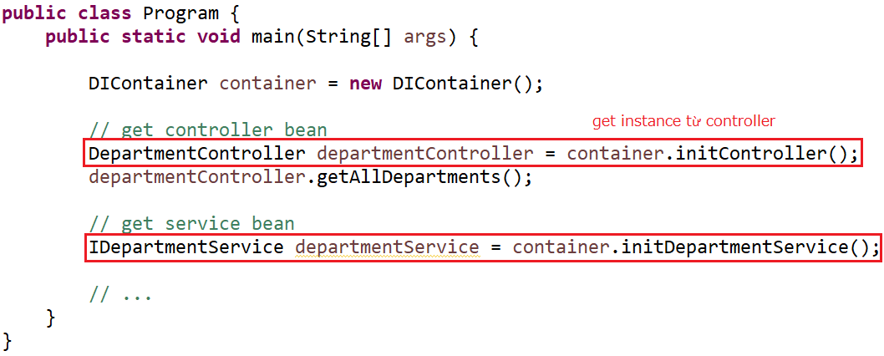
Dependency Injection
Using
Setup DIContainer & Bean

Slide 17
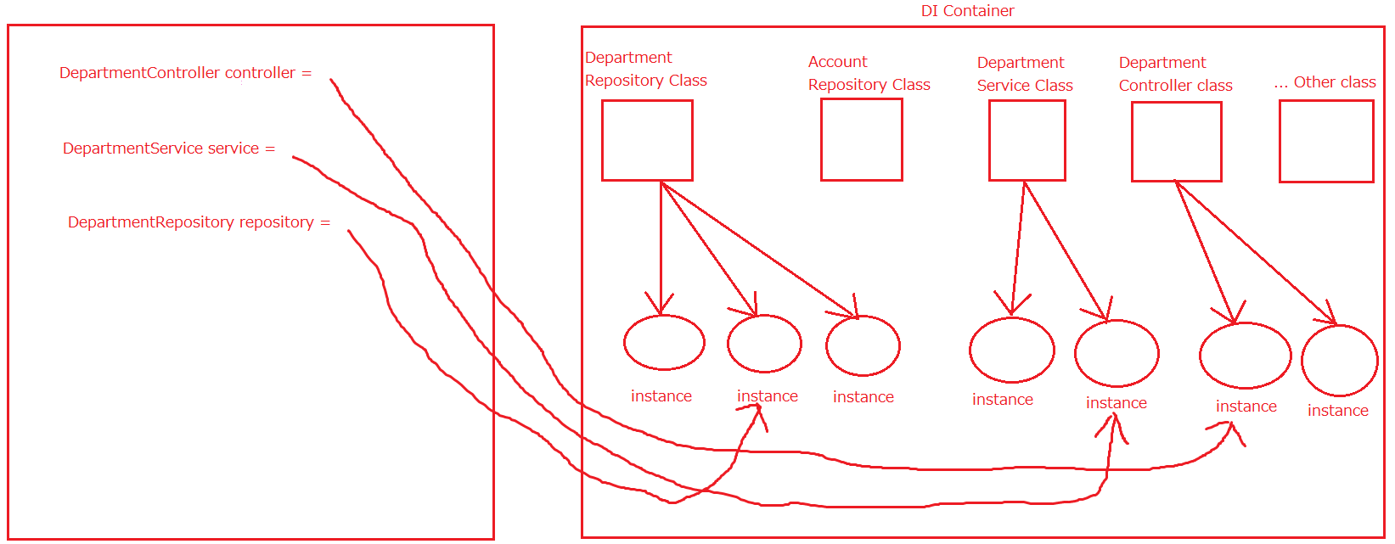
Dependency Injection
Summary

Slide 18
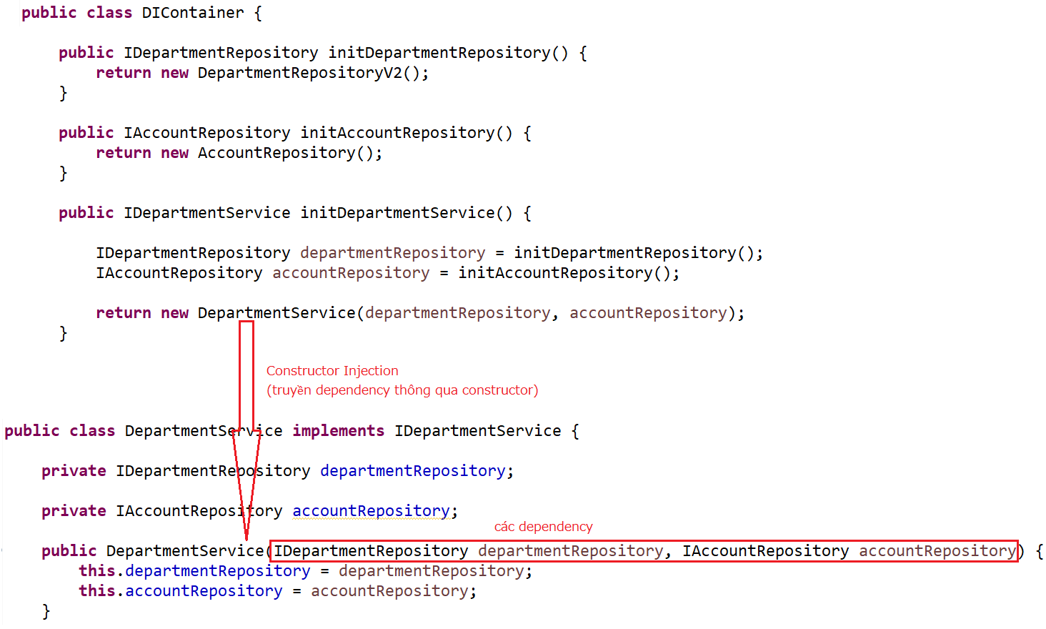
Dependency Injection
Injection

Slide 19
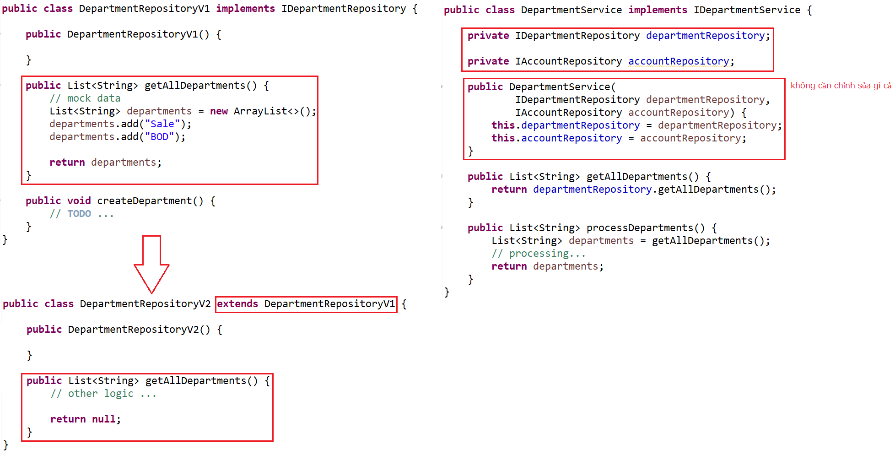
Dependency Injection
Changing code

Slide 20
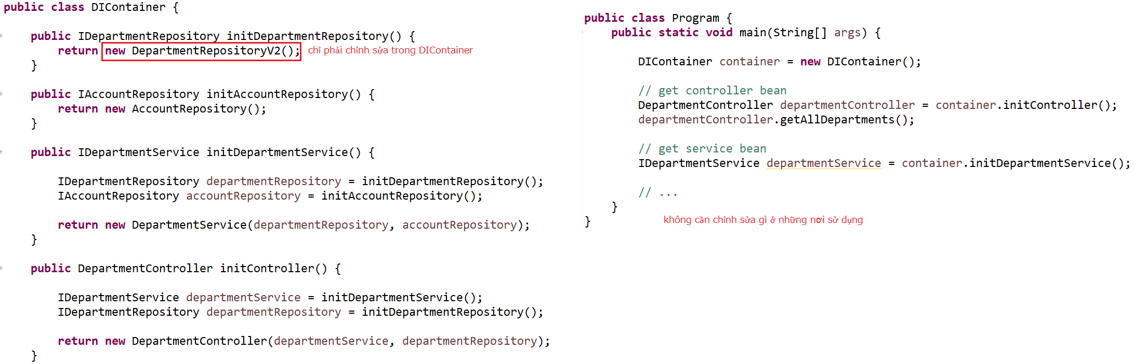
Dependency Injection

Slide 21
Testing System Assignments
Self-practice

Slide 22
Dependency Injection
Dependency modules will be injected into high-level modules
DI is used to reduce dependencies between modules
➔ Easier in module change, code maintenance and testing.
3 Injection ways:
Constructor Injection
Setter Injection
Interface Injection (Self-study)

Slide 23
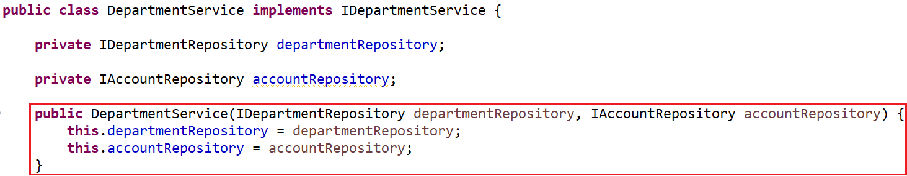
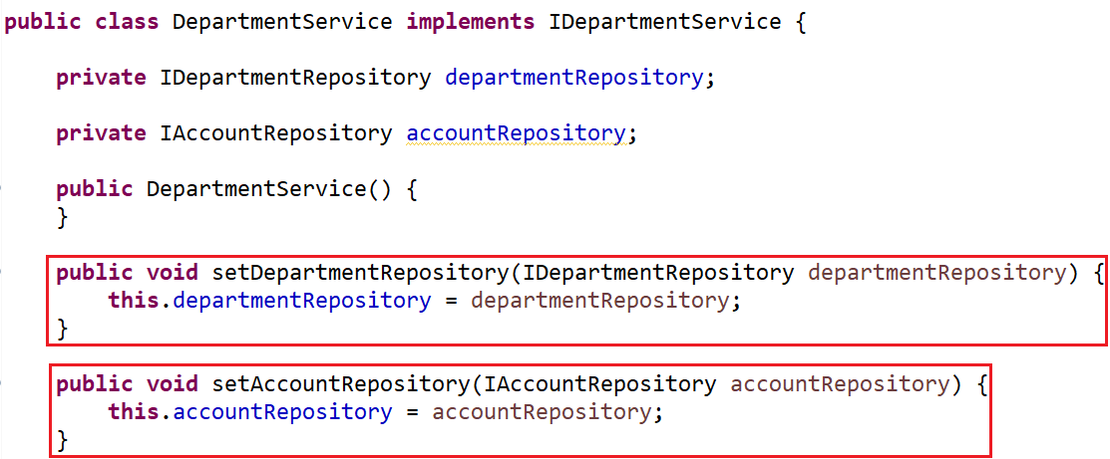
Dependency Injection
Constructor Injection
Setter Injection

Slide 24
Dependency Injection
Advantages & Disadvantages
Advantages | Disadvantages
Reduce adhesion between modules | Confusing DI concept
Easy to maintain | Using interfaces ➔ difficult to debug (we do not know exactly which module is called)
Very easy to test and write Unit Test | Increases the complexity of the code

Slide 25
Testing System Assignments
Self-practice

Slide 26
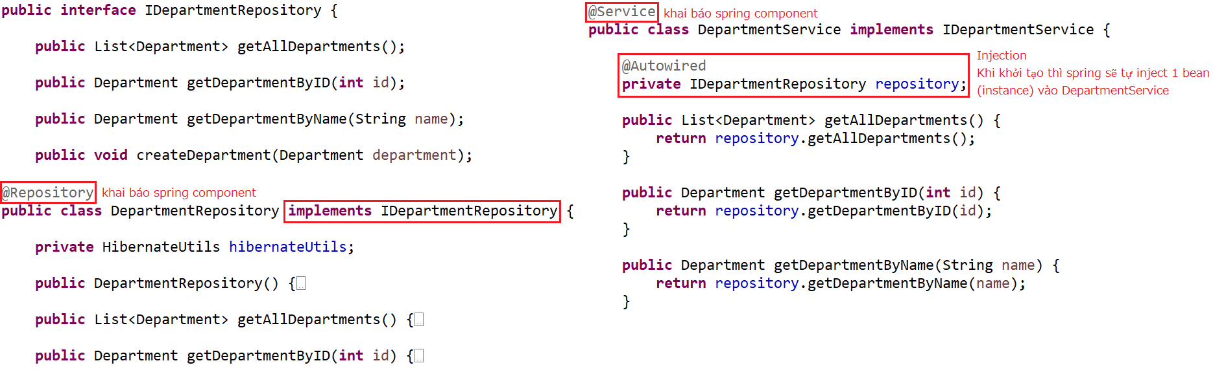
Spring Core
Spring Bean, Spring Component, Spring IOC container

Slide 27
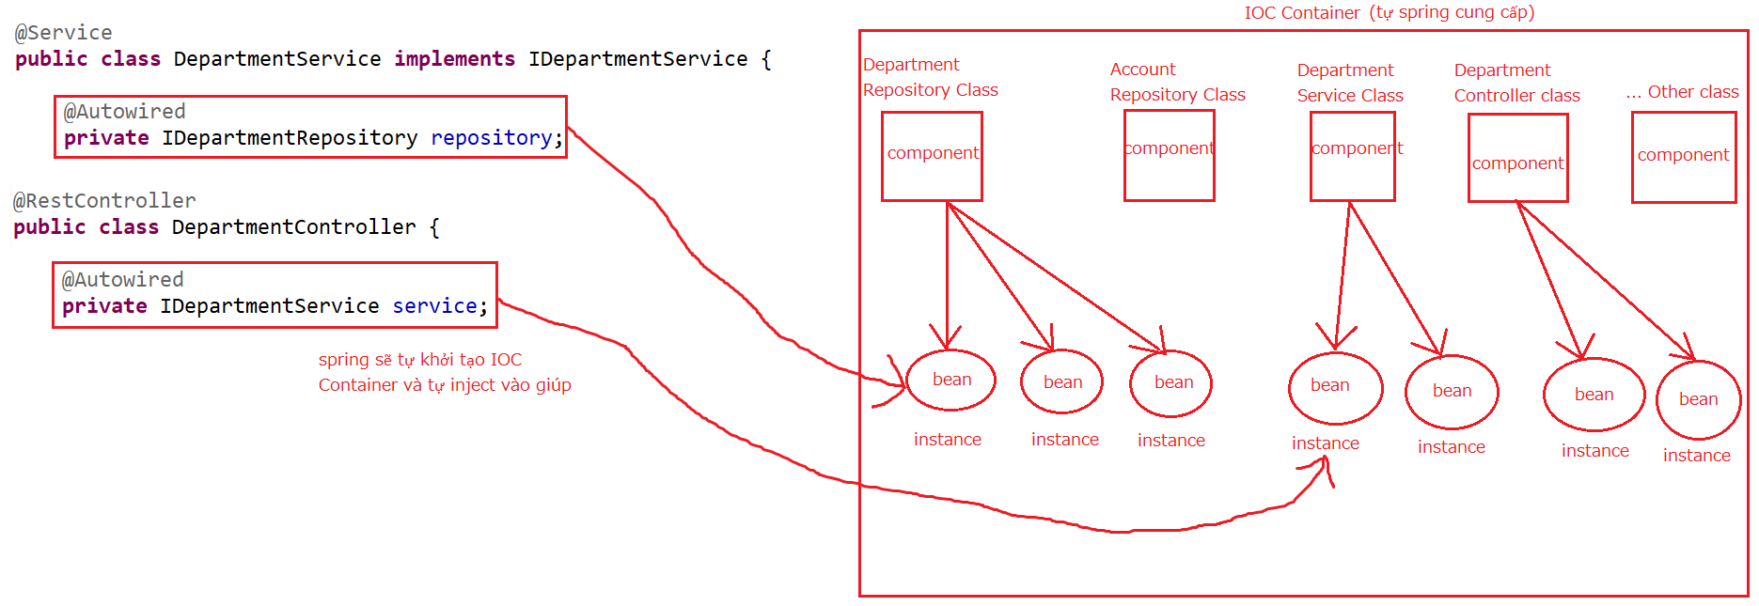
Spring Core
@Autowired

Slide 28
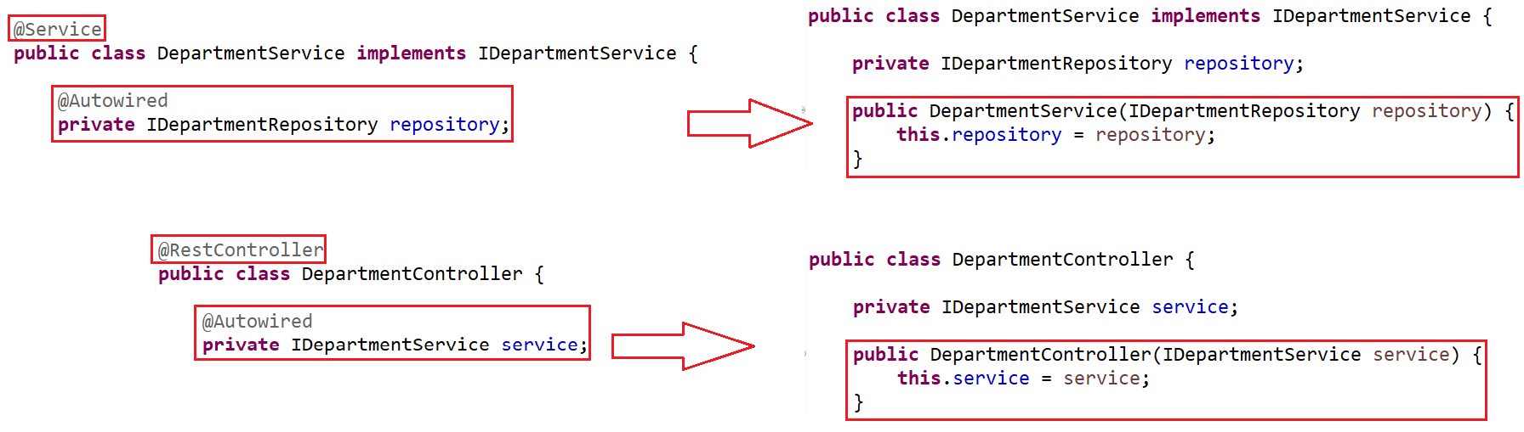
Spring Core

Slide 29
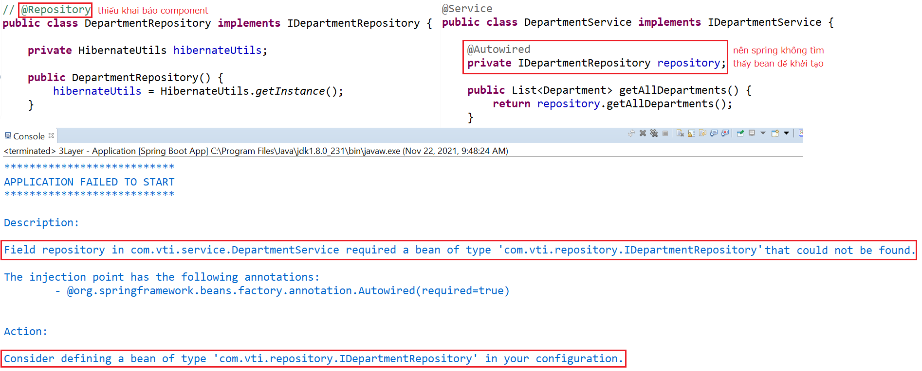
Spring Core
Common Error

Slide 30
Testing System Assignments
Self-practice

Slide 31
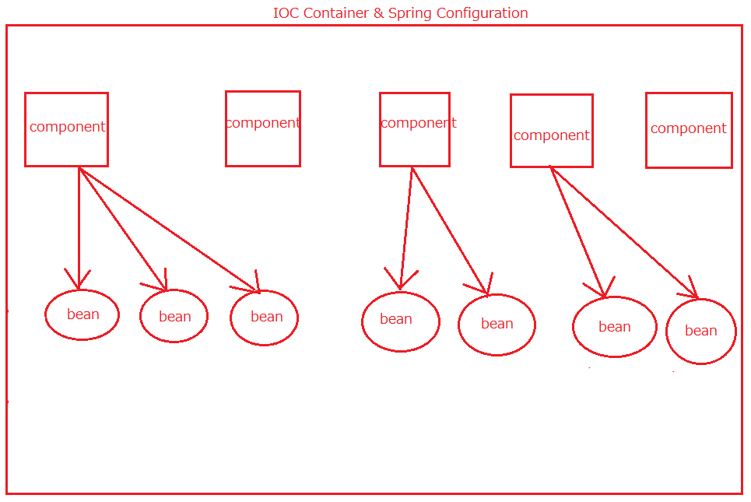
Spring Core
Spring Core component
Spring Component
@Scope
@Autowired & @Qualifier

Slide 32
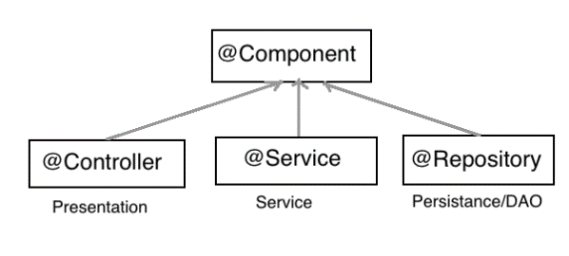
Spring Core
Spring component
@RestController, @Service, @Repository: using for Controller, Service, Repository Object
@Component: using for Other Object
@Configuration, @Bean: using for IOC Container

Slide 33
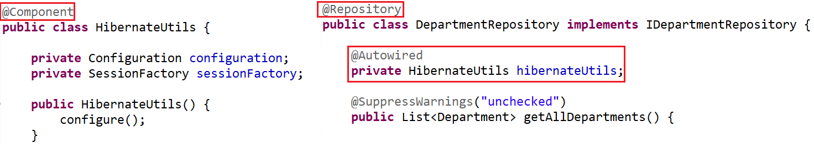
Spring Core
@Component

Slide 34
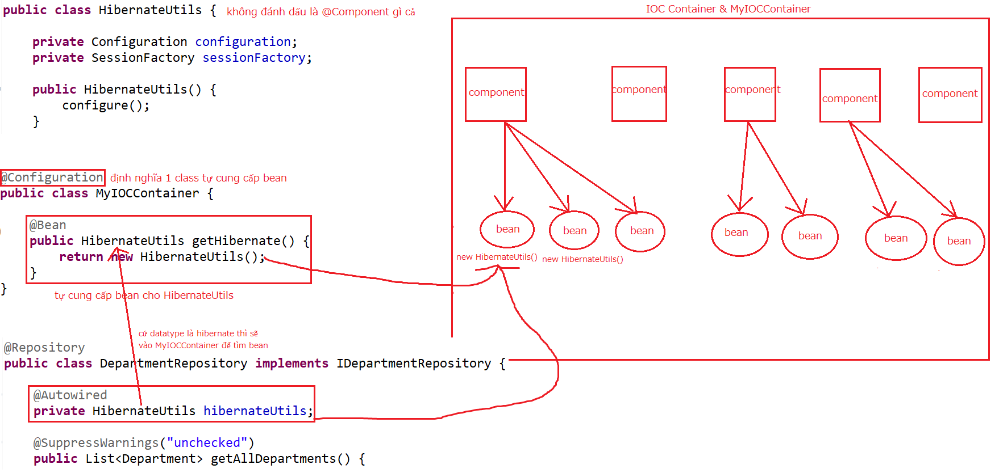
Spring Core
@Configuration

Slide 35
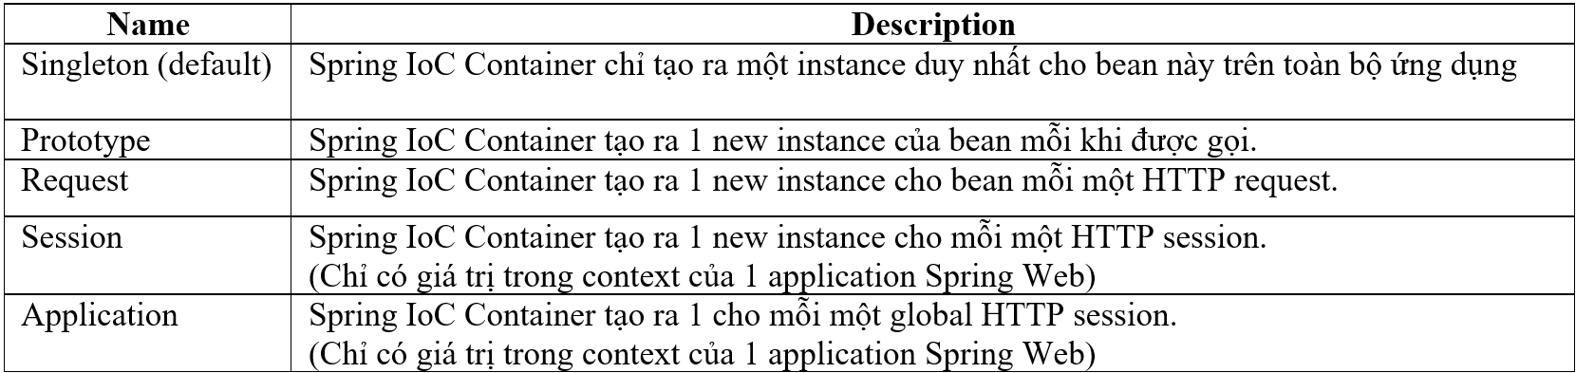
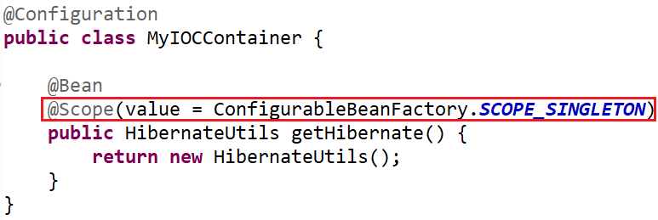
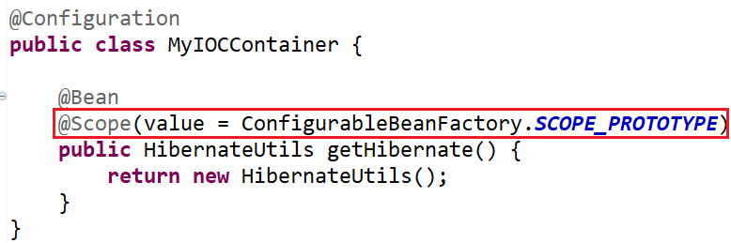
Spring Core
@Scope

Slide 36
Testing System Assignments
Self-practice

Slide 37
Spring Core
@Autowired
3 ways:
On Field
On Constructor
On Setter
@Qualifier & @Primary

Slide 38
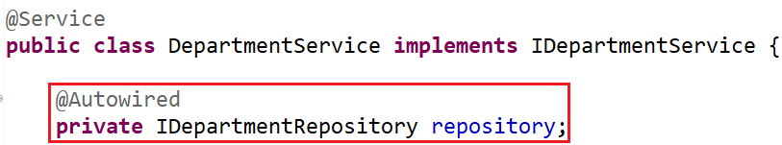
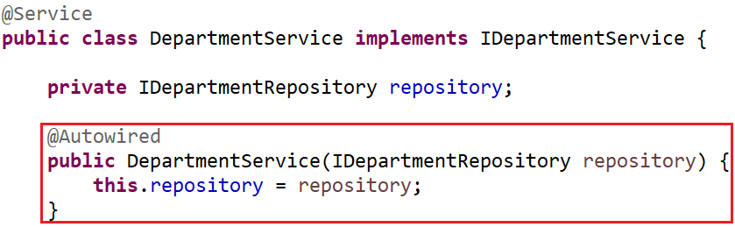
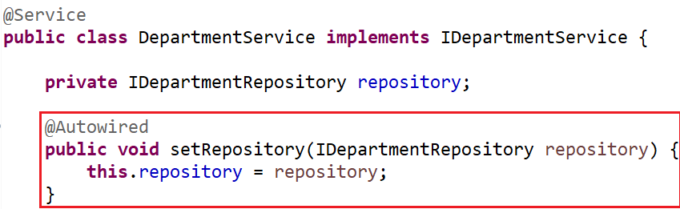
Spring Core
On Field
On Constructor
On Setter

Slide 39
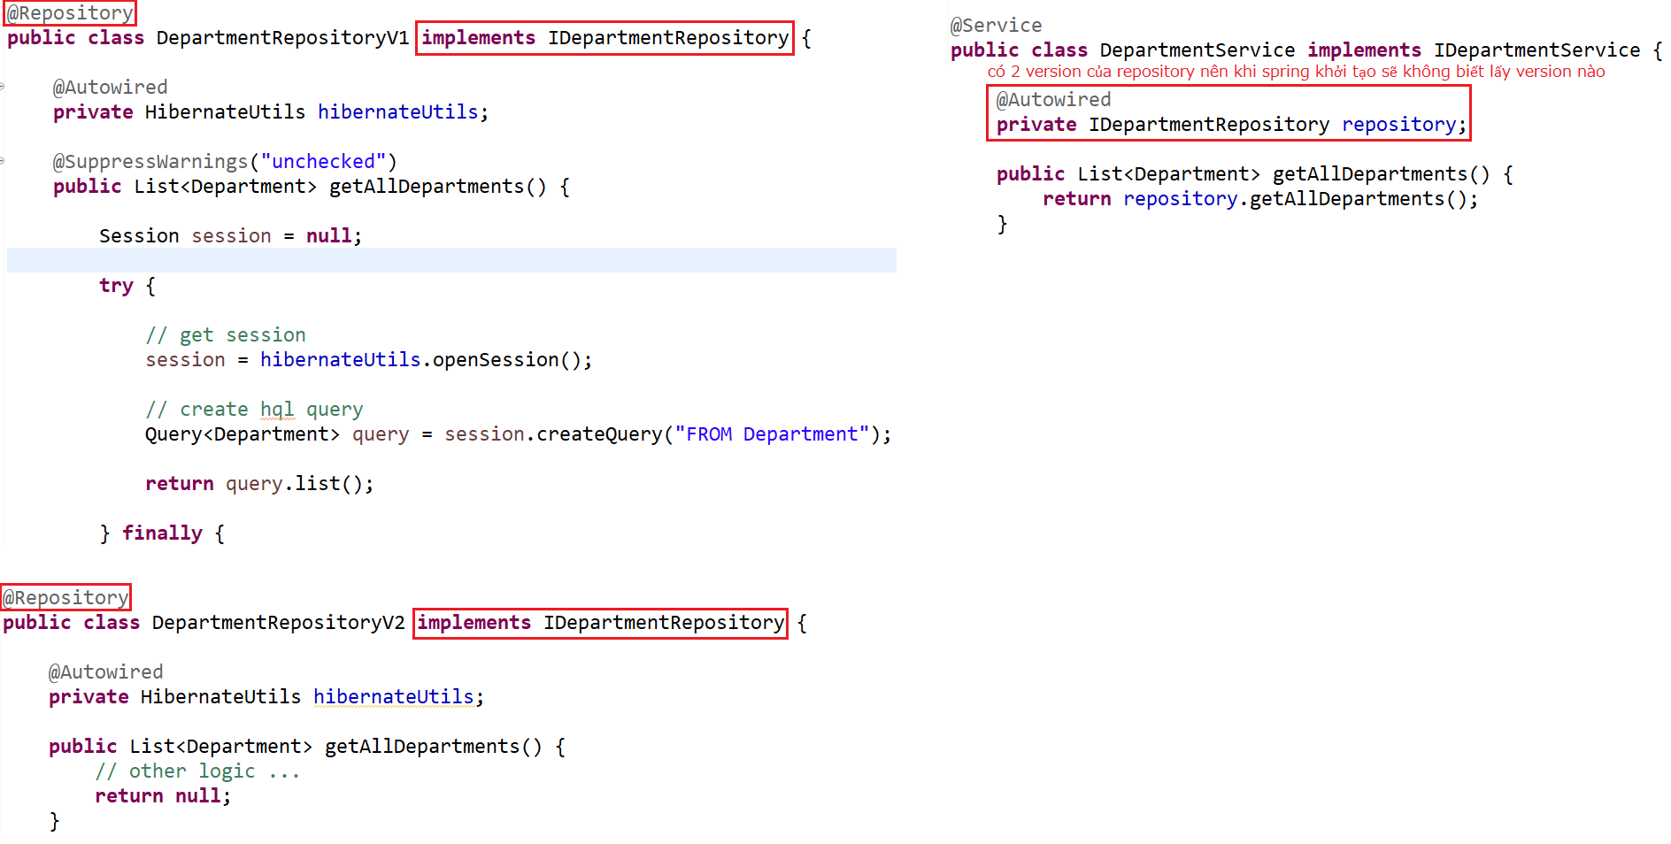
Spring Core
@Qualifier & @Primary
Error

Slide 40
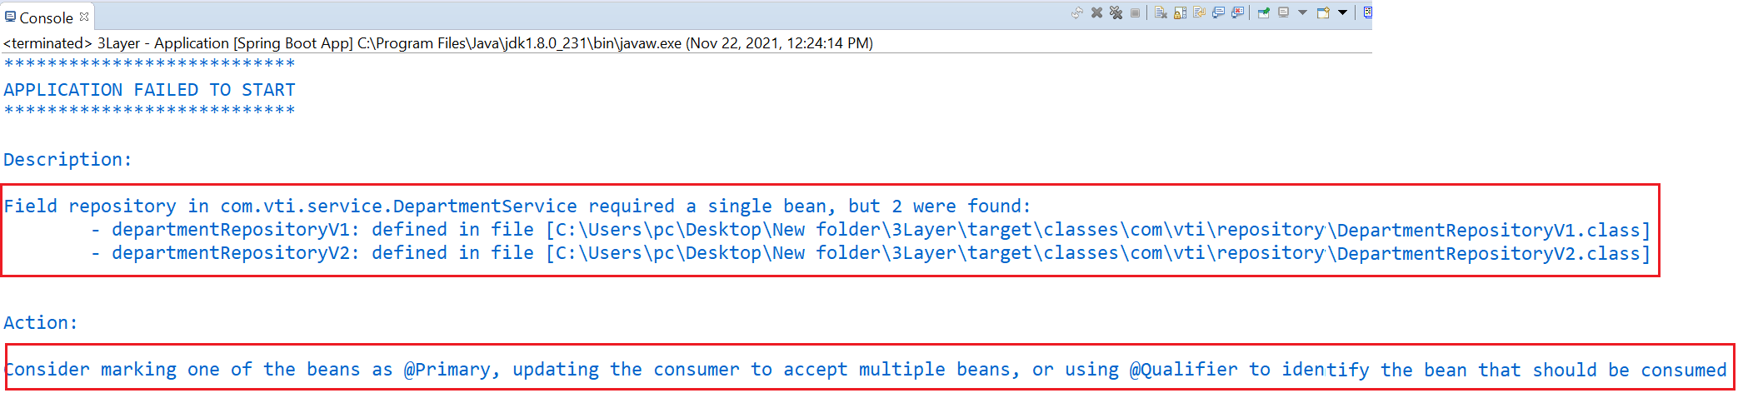
Spring Core
Error

Slide 41
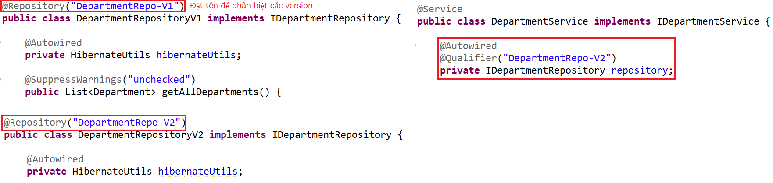
Spring Core
Fix by @Qualifier

Slide 42
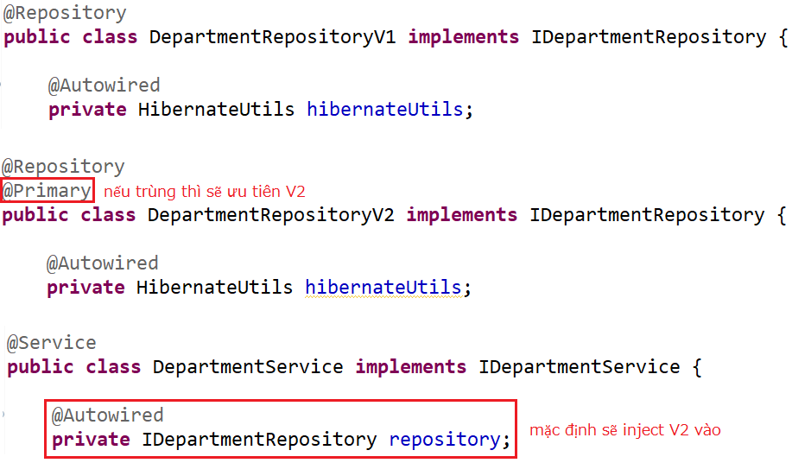
Spring Core
Fix by @Primary

Slide 43
Testing System Assignments
Self-practice

Slide 44
Spring Introduction
Java platform, Open-source
Provides comprehensive infrastructure support for developing Java applications
Design follows DI & IOC, AOP
Home Page: https://spring.io

Slide 45
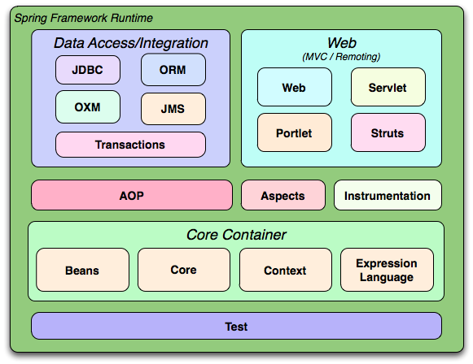
Spring Introduction
Multiple modules

Slide 46
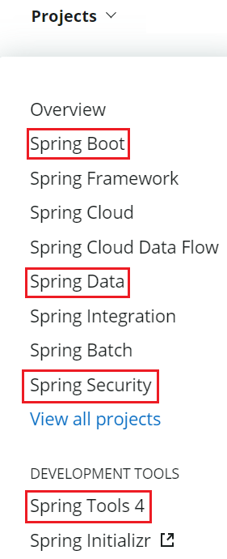
Spring Introduction
Projects
Spring Core (Current Lesson)
Spring Boot (Previous Lesson)
Spring Data (Next Lesson)
Spring Security (Next Lesson)
https://spring.io/projects

Slide 47
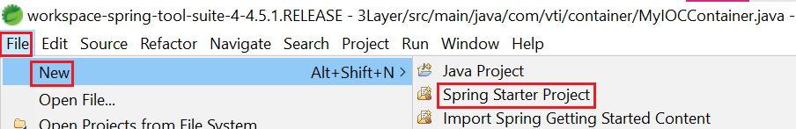
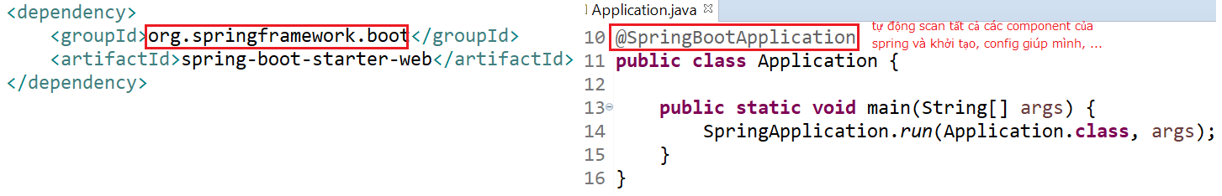
Spring Introduction
Spring Core
IOC & DI Spring Boot
Spring Boot
Help develop and run applications quickly
Easy to create Spring Project, auto config tomcat (server), libraries, ...

Slide 48
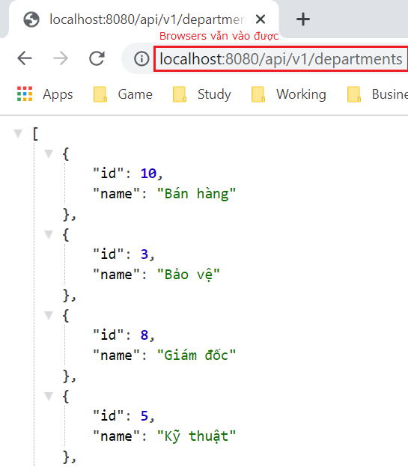
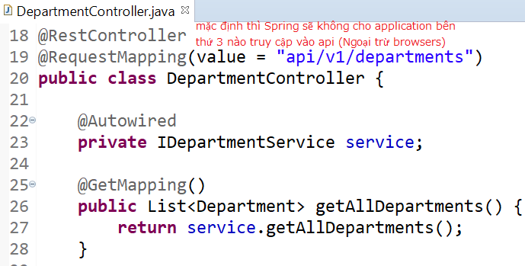
Other
@CrossOrigin

Slide 49
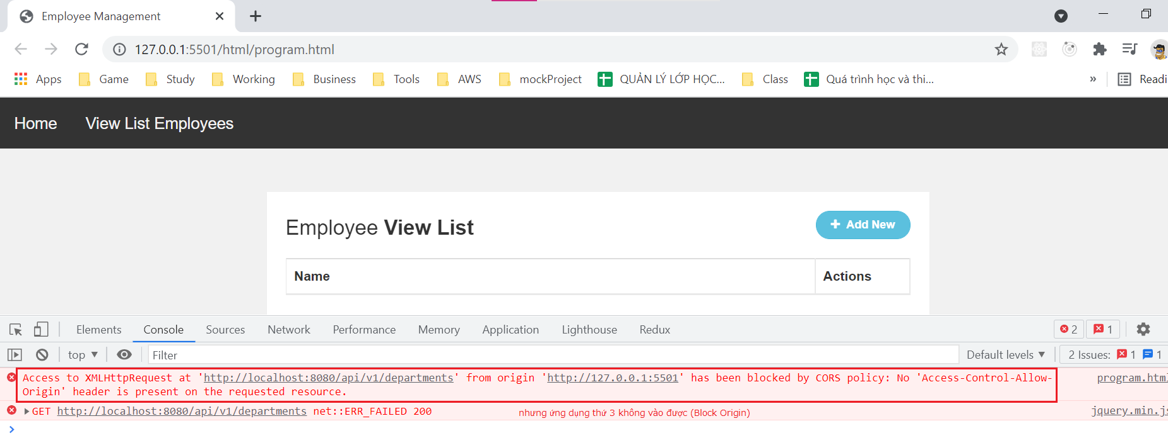
Other
Error

Slide 50
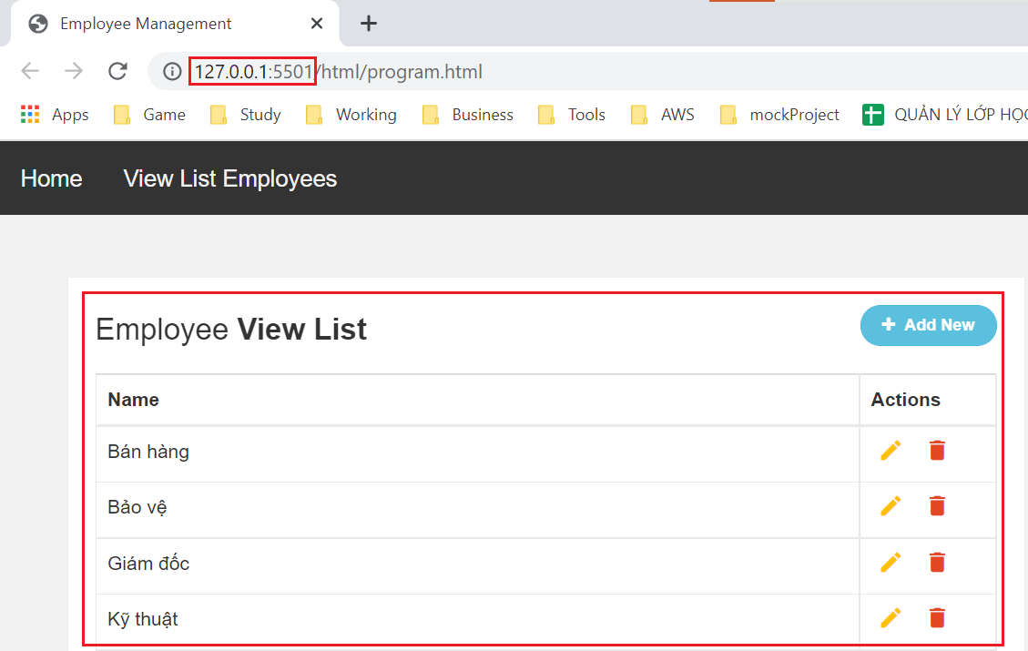
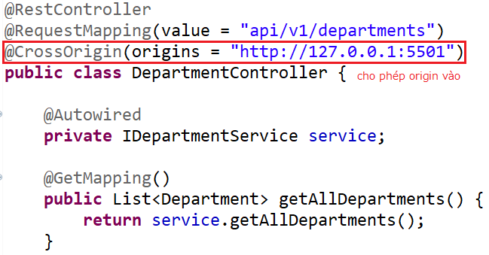
Other

Slide 51
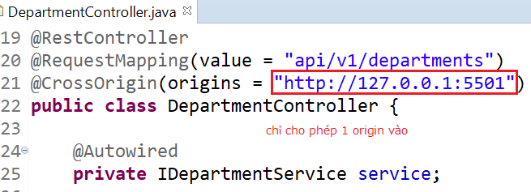
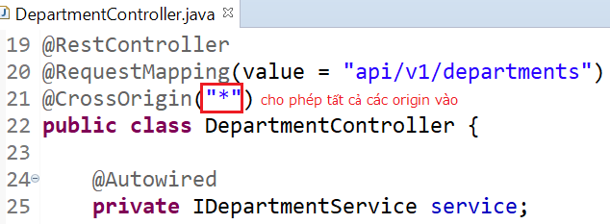
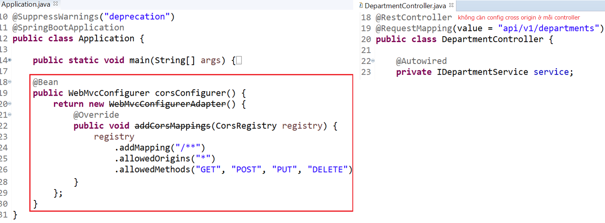
Other
Apply to Each Controller
Apply to All Controllers

Slide 52
Testing System Assignments
Self-practice

Slide 53
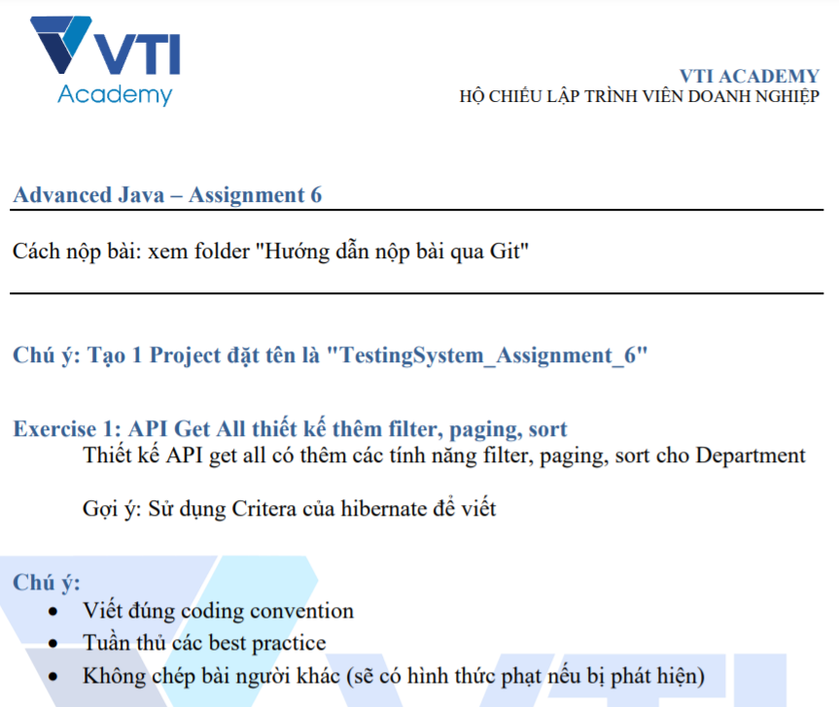
Testing System Assignments

Slide 54
Reference
https://www.baeldung.com
https://spring.io/projects/spring-boot
https://spring.io/guides#getting-started-guides

Slide 55
Q & A
Copyright © VTI Academy All Rights Reserved

